Slide 1



Net Zero is Peace?
Beyond Apocalypsis Crisis:
Dr. Ievgeniia Kopytsia
MSCA4Ukraine Research Fellow
Associate Professor NLU, Ukraine
Notes:
EXTRA https://www.pnnl.gov/sites/default/files/media/file/Ukraine%20NZW%20COP28%20report%202023.pdf - CLEAN ENERGY ROADMAP:
FROM RECONSTRUCTION TO DECARBONIZATION IN UKRAINE

Slide 2
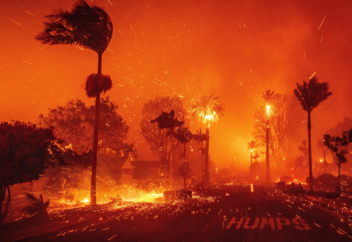
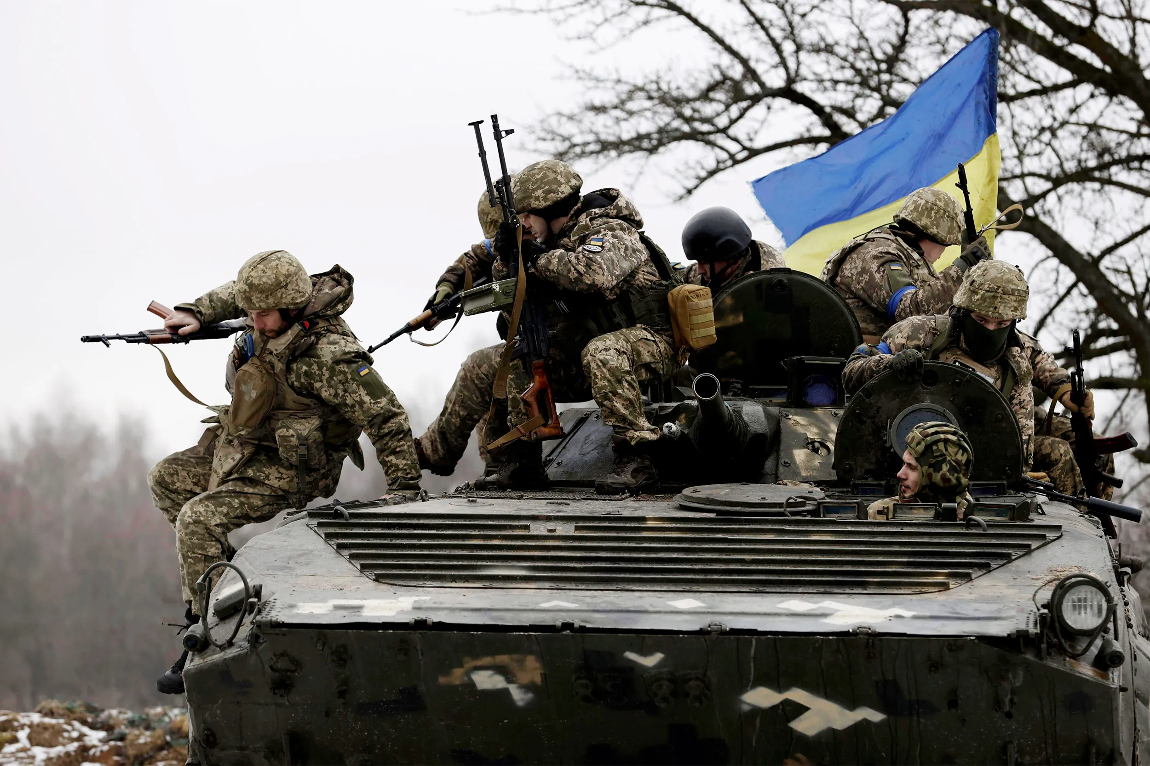
What is in common?
Wildfires California 2024
Russian War Against Ukraine 2014 – present

Slide 3
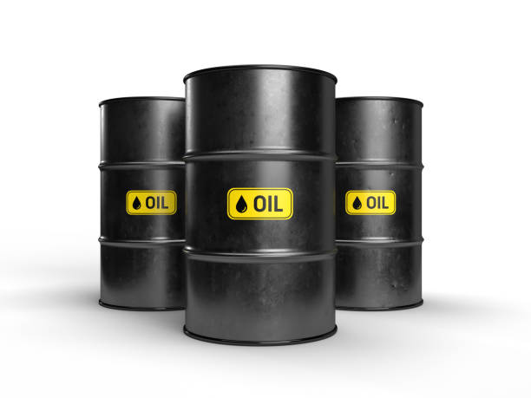
Fossil Fuels
Coal, oil and gas extraction has a lasting legacy of violence and destruction,
from the Sudanese Civil War, the killings of Indigenous communities in Nigeria to contemporary conflicts in Mozambique.
Notes:
Wars have long been fought over resources, but fossil fuels have become a primary driver of conflict in the modern era. This relationship has profound implications for international stability, economic security, and environmental sustainability. The ongoing war in Ukraine exemplifies in perfect clarity the dire consequences of fossil fuel dependency, serving as a wake-up call for the global community.
Nigeria: Oil, poverty and violence
“It is like paradise and hell. They have everything. We have nothing… If we protest,
they send soldiers. They sign agreements with us and then ignore us. We have
graduates going hungry, without jobs. And they bring people from Lagos to work
here.” Eghare W.O. Ojhogar, chief of the Ugborodo community in Delta State
On 4 February 2005, soldiers fired on protesters at Chevron’s Escravos oil terminal
on the coast of the western Niger Delta killing one man and injuring at least 30 others.
Chevron Nigeria, the subsidiary that operates the terminal, said that the protesters
were armed with guns, although none appeared to have been seized by the security forces or captured on video recordings of the incident.
Cabo Delgado, Mozambique: A Resource-Rich War Zone
https://gogel.org/cabo-delgado-mozambique-resource-rich-war-zone

Slide 4
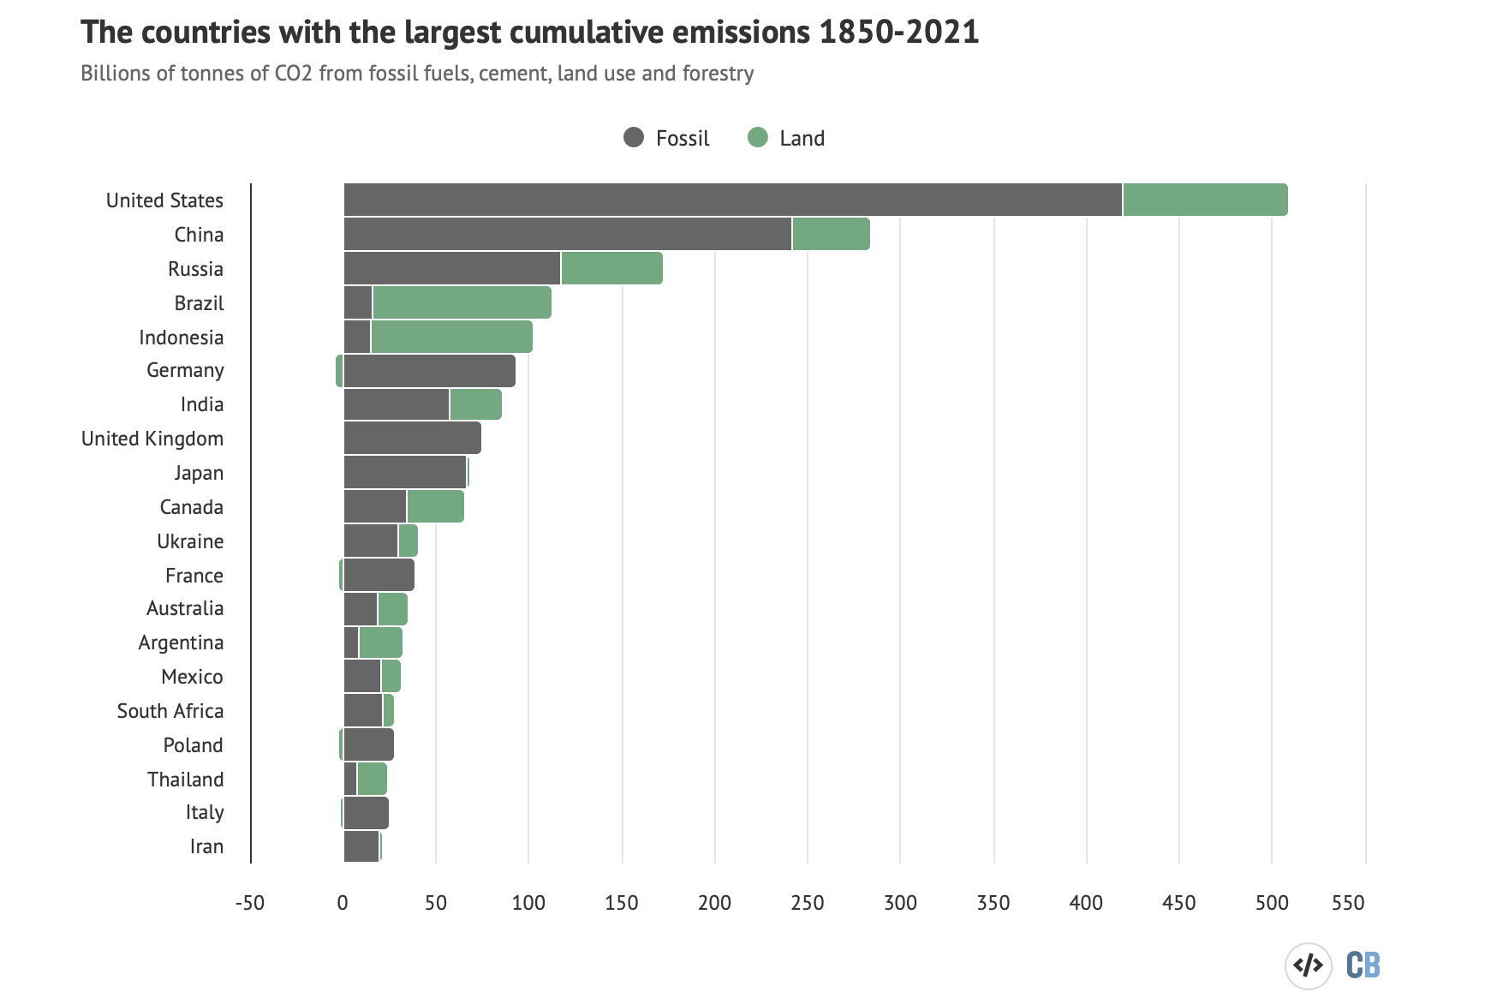
Energy as
Resource of:
Climate crises
Injustice
Inequalities
Notes:
Source: Analysis: Which countries are historically responsible for climate change?”, Carbon Brief, 2021 https://www.carbonbrief.org/analysis-which-countries-are-historically-responsible-for-climate-change/
According to Oxfam study, the richest 1% of the world’s population accounts for twice as much CO2 emissions as the poorest 50% of the population. However, more than 91% of deaths caused by climate-related disasters over the past 50 years have been in developing countries.
The countries most responsible for historical emissions are now experiencing the compounded effects of climate crises, which strain their political systems and contribute to democratic backsliding. Inadequate or repressive responses to these crises erode public trust, deepen inequalities, and threaten the foundations of democratic governance. Addressing both climate change and democratic erosion requires transparent, inclusive, and effective governance—something increasingly at risk in these high-emitting nations

Slide 5
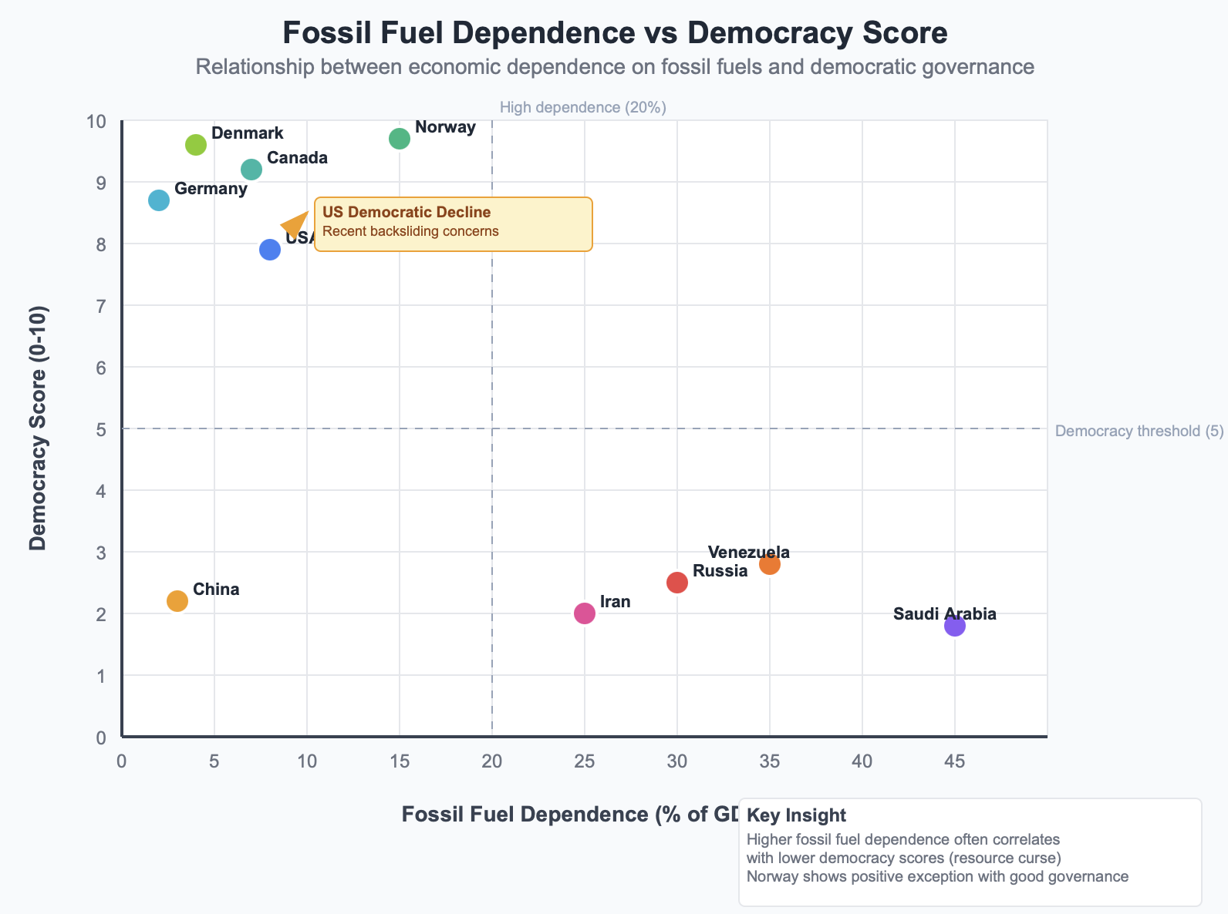
Energy Fossil Fuels as Source of Democratic Backsliding
Notes:
This graph illustrates the relationship between fossil fuel dependence and democratic backsliding. Countries with higher reliance on fossil fuels tend to have lower democracy scores, supporting the argument that fossil fuel wealth can undermine democratic institutions
The US democracy score has declined in recent years, with concerns about democratic norms, polarization, and the rule of law.
Trump Factor: Trump’s policies favor fossil fuel expansion and deregulation, aligning with interests that often resist democratic reforms and climate action.

Slide 6
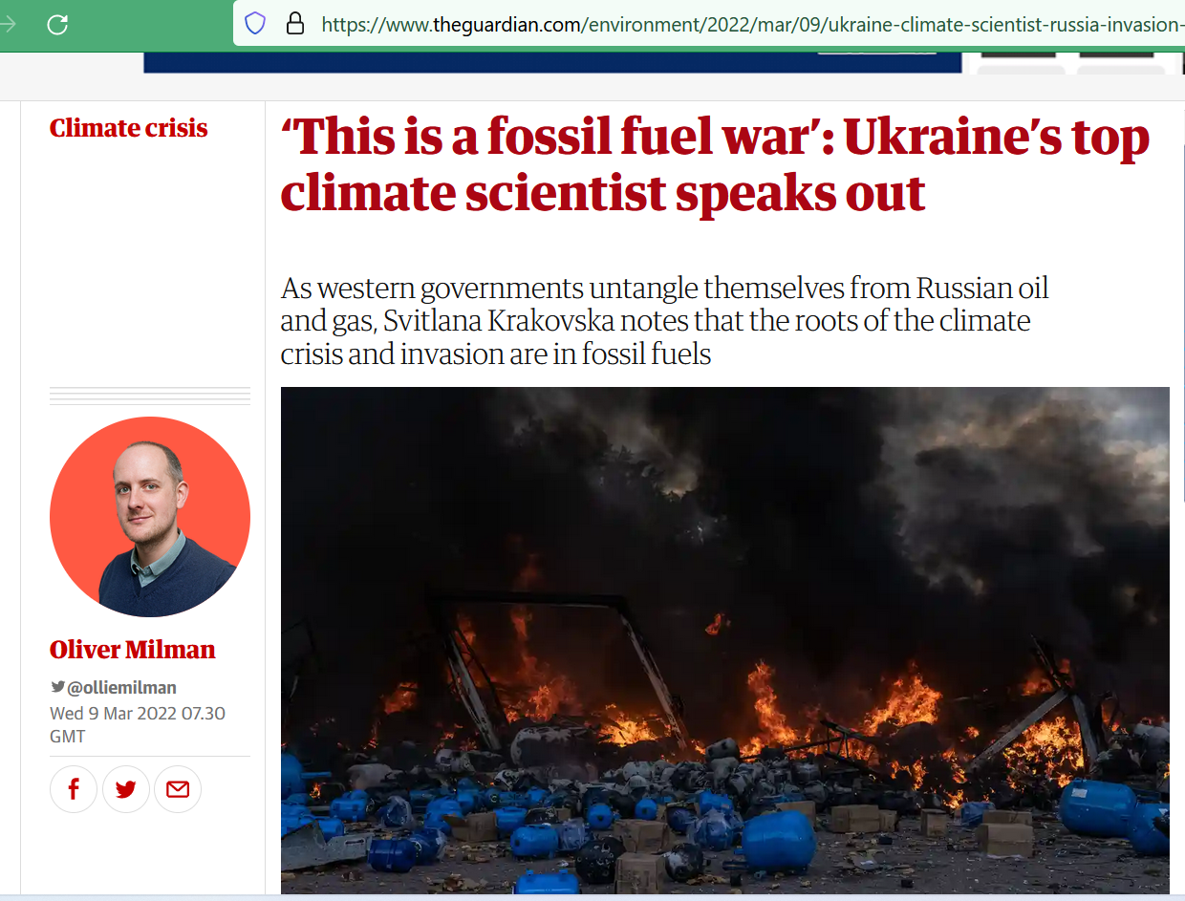
Energy Fossil Fuels as Source of War
2021 Finnish Institute of International Affairs:
“the Western-driven transition away from a fossil fuel-based economy towards a renewable energy-based economy may deepen the Russian leadership’s suspicions about global climate policy.
Following Henderson and Mitrova, “the global rise in renewable energy source targets and the transition towards a decarbonized energy economy are regarded in Russia as a significant threat for export revenues and thus for Russian economic, and therefore political, security.”
Notes:
Russia meets climate change: The domestic politicization of environmental issues and external pressure to decarbonize
FIIA Briefing Paper(303). Finnish Institute of International Affairs.

Slide 7
The Vicious Cycle or the Price of Dependency
$7 trillion was spent globally on fossil fuel subsidies in 2022, with a substantial portion directly benefiting fossil fuel advocates.
Fueled by these subsidies, Russia earned over EUR 800 billion in revenues from fossil fuel exports since the onset of the full-scale war in Ukraine, giving it the ability to channel these funds towards militarization and weapon production.
Belgium, which allocated approximately 350 million euros for humanitarian assistance to Ukraine while simultaneously investing billions in Russian liquefied natural gas (LNG).
The EU spent 8.3 billion on Russian LNG in 2023, even as it facilitated LNG exports to China and India through ongoing transshipments in the port of Zeebrugge.

Slide 8
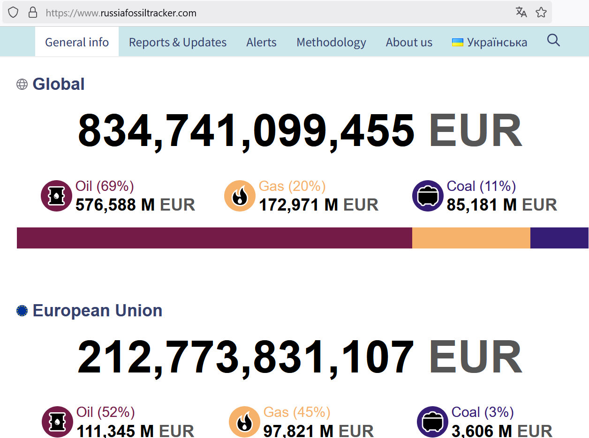
Average EU citizen has paid more than 500 EUR for Russian fossil fuels since invasion
https://www.russiafossiltracker.com

Slide 9
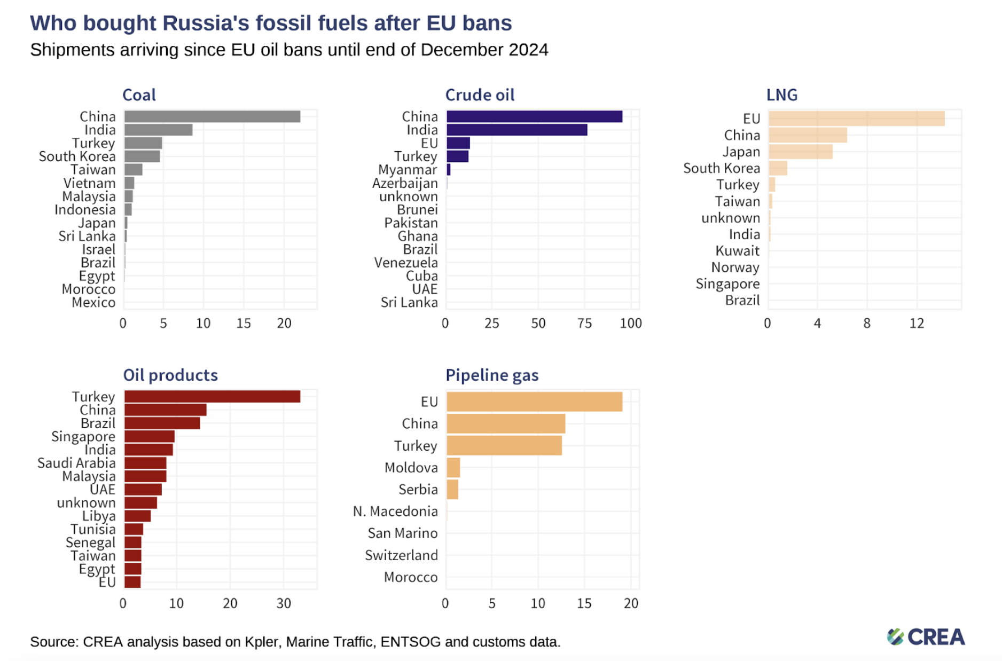
Despite the outcry against Russia’s aggression in Ukraine, European and G7 countries’ policies remain contradictory. While publicly condemning Russia’s actions, these nations continue to provide financial support through fossil fuel purchases.
Notes:
“December 2024 — Monthly analysis of Russian fossil fuel exports and sanctions”, CREA, 2025 https://energyandcleanair.org/december-2024-monthly-analysis-of-russian-fossil-fuel-exports-and-sanctions/

Slide 10
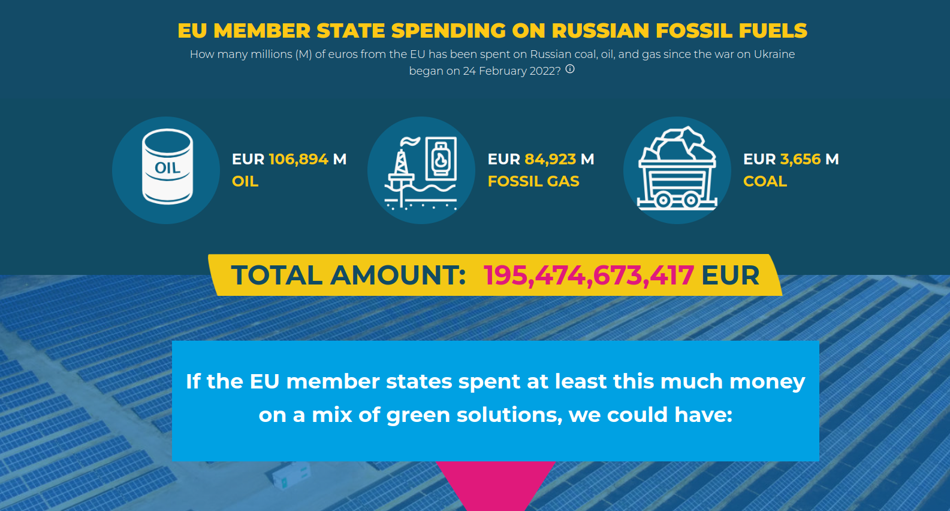
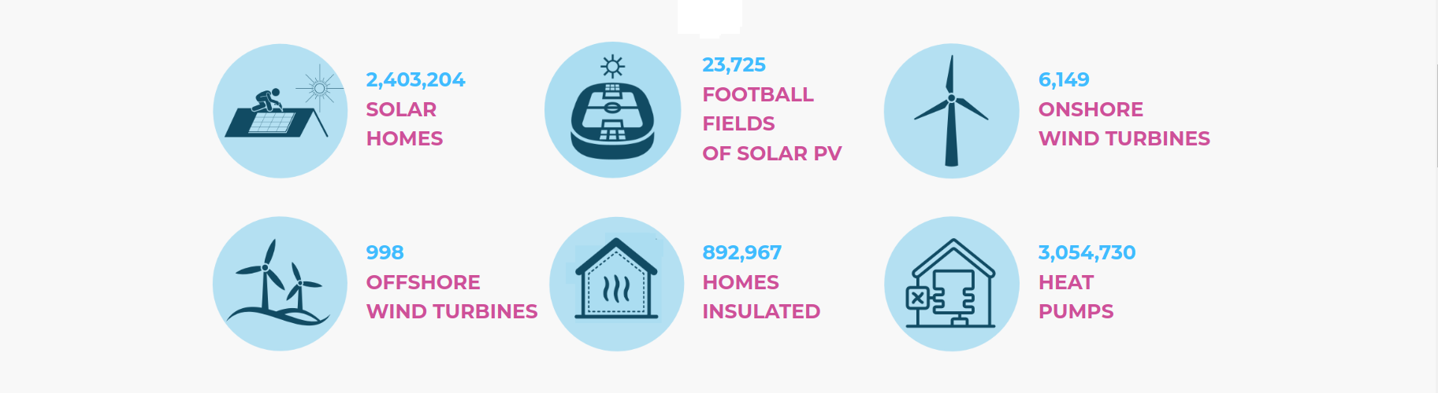
The European Union has chosen a strategy for sanctions policy that inflicts maximum damage with minimal losses. In its summary of the sanctions, the European Council describes the list of banned products as “...designed to maximize the negative impact of the sanctions on the Russian economy while limiting the consequences for EU businesses and citizens.”
Notes:
https://uwecworkgroup.info/an-environmental-perspective-are-sanctions-against-russia-working-and-if-not-why-not/

Slide 11
INSTEAD:

Slide 12
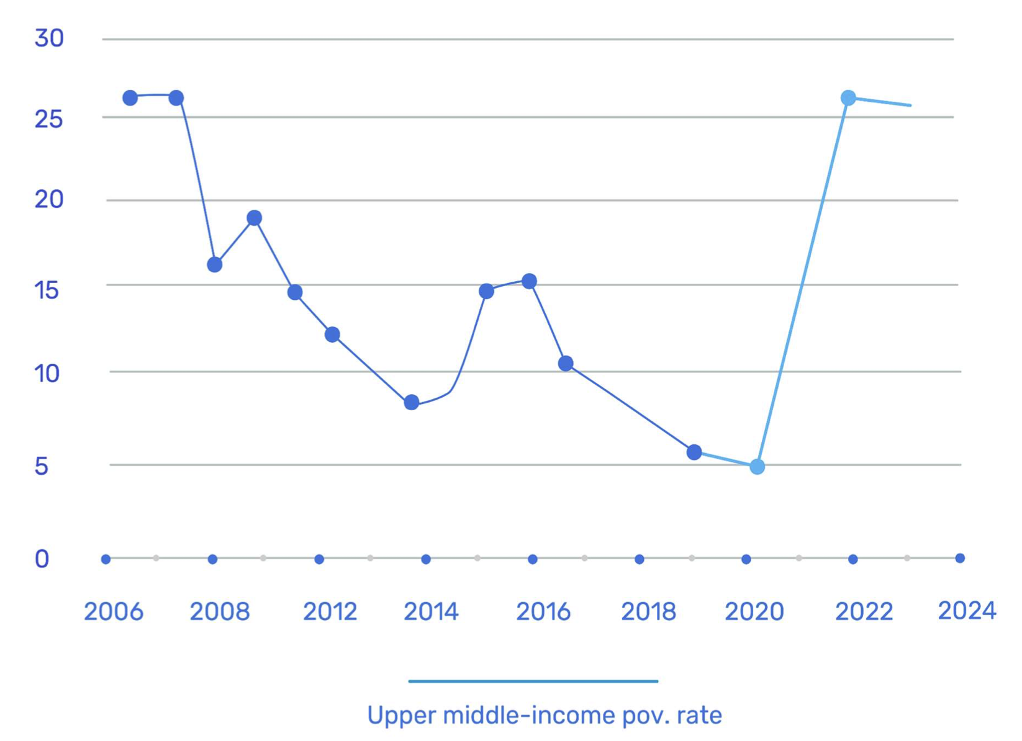
The Russian war against Ukraine has caused unprecedented damage.
Poverty Rate, Ukraine
Russia's invasion in February 2022 severely damaged Ukraine's economy, suspending exports and destroying critical infrastructure.
Ukraine's GDP crashed 29.1% in 2022.
Key export industries like metals and agriculture have suffered major losses from damage to machinery, land, and stored goods.
73% of Ukraine's jobs were in small and medium businesses before the war. Many have closed or laid off workers due to plunging demand, supply issues, and safety threats.
The enormous loss of human capital (as of March 2025):
- 12,910 civilians killed
- 30,700 civilians injured
- 6.3 million Ukrainian refugees in Europe
- 6.8 million worldwide
Notes:
https://www.statista.com/statistics/1293492/ukraine-war-casualties/Still Under Fire:
The Evolving Fate of Civilians in Ukraine : https://acleddata.com/2024/02/22/still-under-fire-the-evolving-fate-of-civilians-in-ukraine/

Slide 13
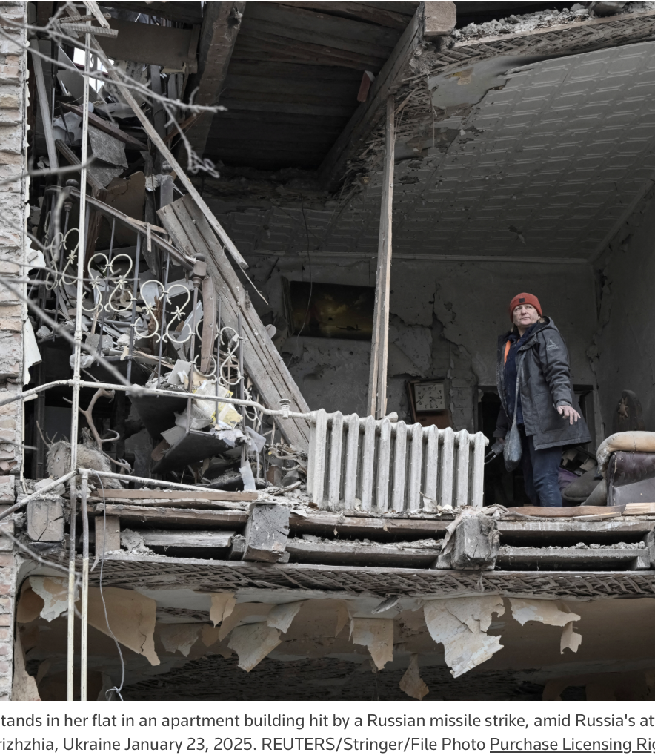
The reconstruction of Ukraine might become one of the most difficult multilateral challenges of the 21st century.
Estimated costs €506 billion (£420 billion) - 2.8 times the estimated nominal GDP of Ukraine for 2024
The highest estimated recovery and reconstruction needs are in:
  housing (17%)
  transport (15%)
  commerce and industry (14%)
  agriculture (12%)
  energy (10%)
  social protection and livelihoods (9%)
  and explosive hazard management (7%)
Reconstruction must address not only physical rebuilding but also social, economic, and environmental renewal.

Slide 14
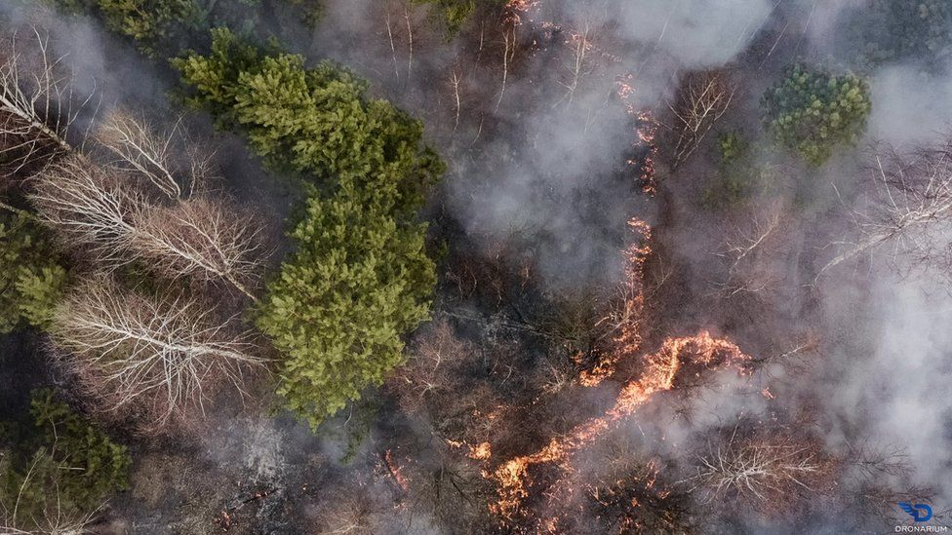
Nature is a Silent Victim
Environmental damage to date carries a total cost of $200 billion.
Over 20% of Ukraine's forests- 1 million hectares - burned by rockets or projectiles.
At least 10 years to restore.

Slide 15
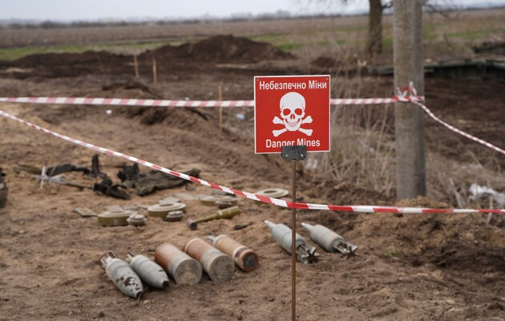
Ukraine is currently the most mined country in the world since the WWII-
174,000 square km of the mined territory.

Slide 16
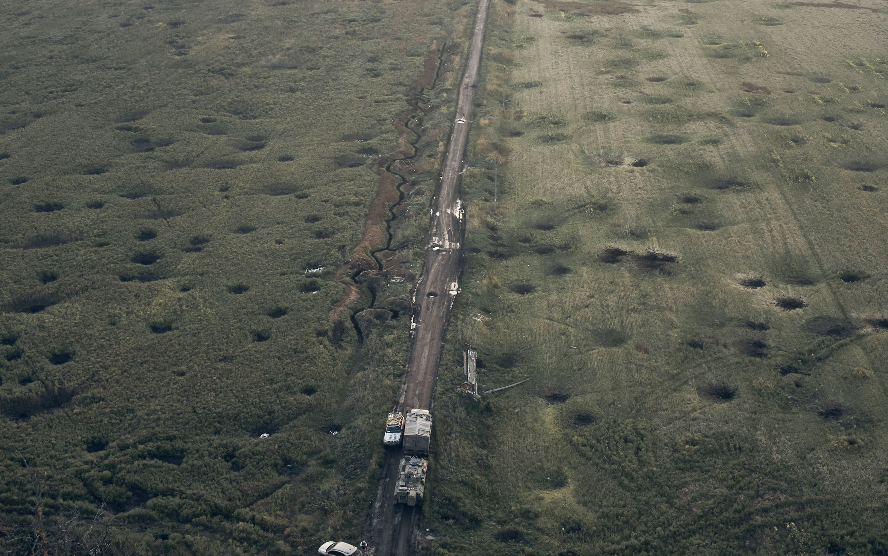
30% of Ukraine’s agricultural land was uncultivated in 2023 due to explosives contamination.
A field is covered with craters left by the shelling close to Izium, Kharkiv region, Ukraine, Tuesday, Sept. 13, 2022.
Notes:
FAO. 2023. Ukraine: Impact of the war on agricultural enterprises – Findings of a nationwide survey of agricultural enterprises with land up to 250 hectares, January–February 2023. Rome.
https://doi.org/10.4060/cc5755en
https://en.interfax.com.ua/news/economic/973200.html

Slide 17
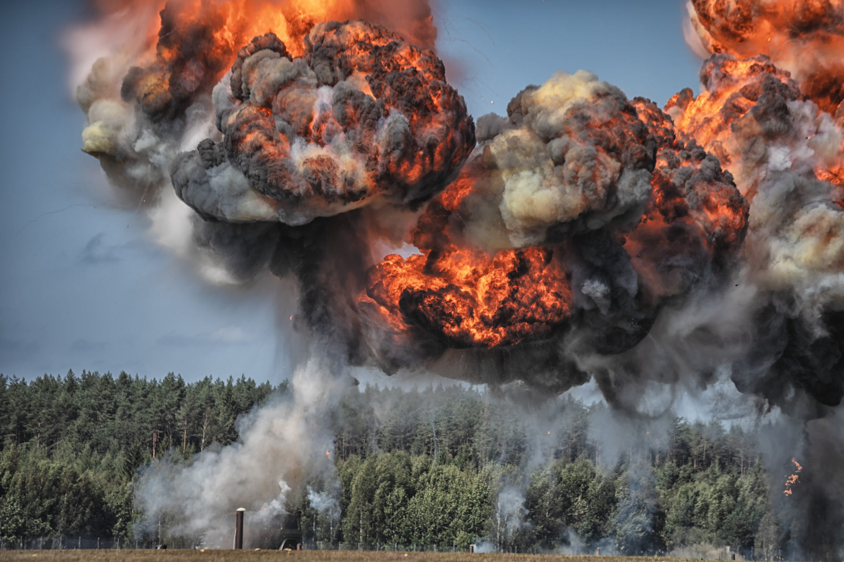
As of December 2024, greenhouse gas emissions linked to the warfare reached 175 million tons of CO2 equivalent = equals the CO2 emission of a country like Belgium
On April 29, 2022, the Cabinet of Ministers of Ukraine approved changes to the Procedure for determining damage and losses caused to Ukraine as a result of the armed aggression of the Russian Federation, and expanded the directions by which damage caused to the environment of Ukraine will be determined.
No accountability measures for conflict-related emissions yet

Slide 18
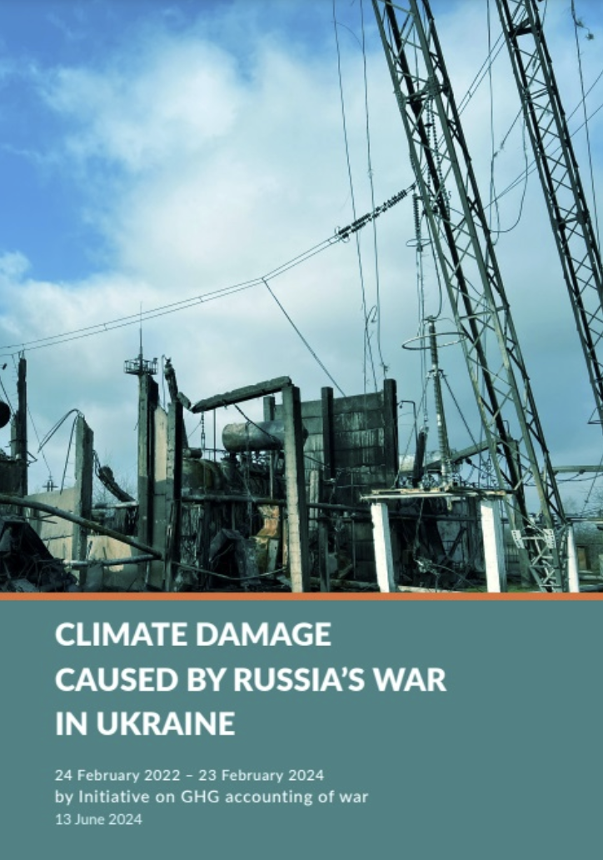
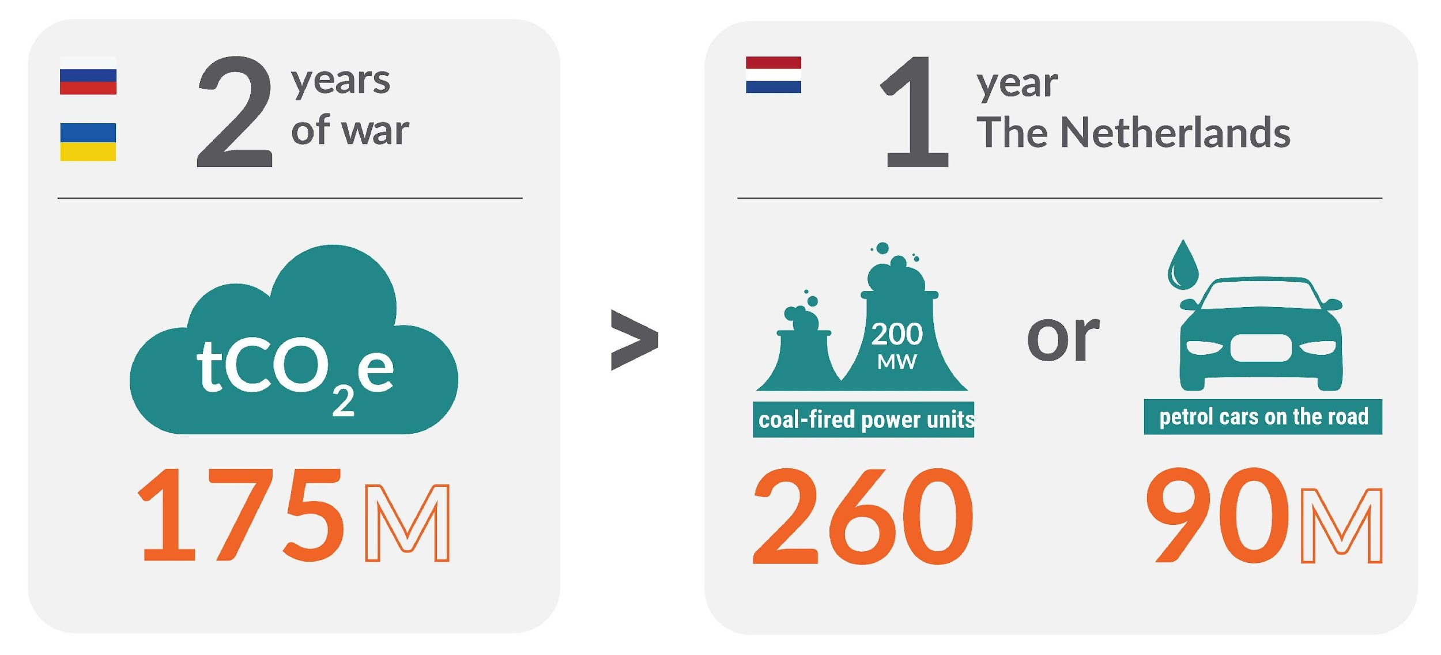


GHG emissions after 2 years of Russia’s war
Notes:
“Climate damage caused by russian war in Ukraine in 24 months”, Initiative on GHG Accounting of War, 2024 https://en.ecoaction.org.ua/climate-damage-by-russia-24-months.html

Slide 19
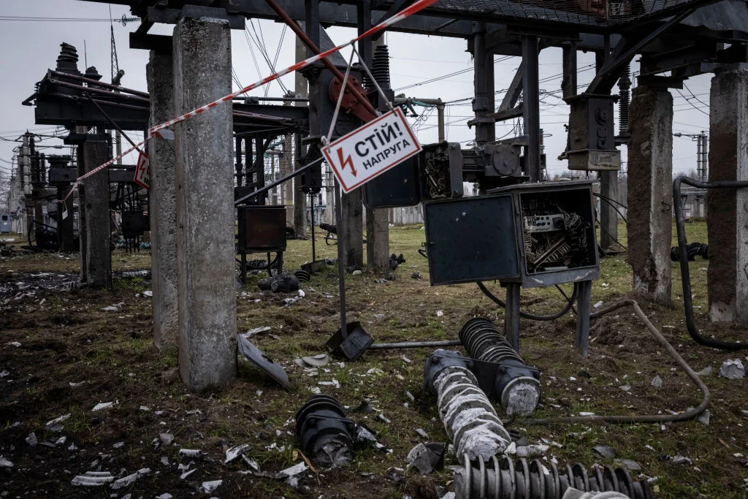
Since 2022, Russian armed forces has been deliberately targeting energy infrastructure facilities.
2022 – 2023 - targeted attacks on the distribution systems
2024 - strategic attacks on power plants
Energy as Target
Prior 2022, Ukraine could generate up to 32 GW of power, with actual generation around 25 GW. Today, Ukraine struggles to produce 9 GW.
Notes:
Prior to the full-scale invasion, Ukraine had approximately 56 GW of transmission capacity in its energy system, giving it considerable resilience to redirect energy as key substations were destroyed. Today, the transmission capacity is close to Ukraine's generating capacity, limiting options for rerouting energy when parts of the grid are cut off.

Slide 20
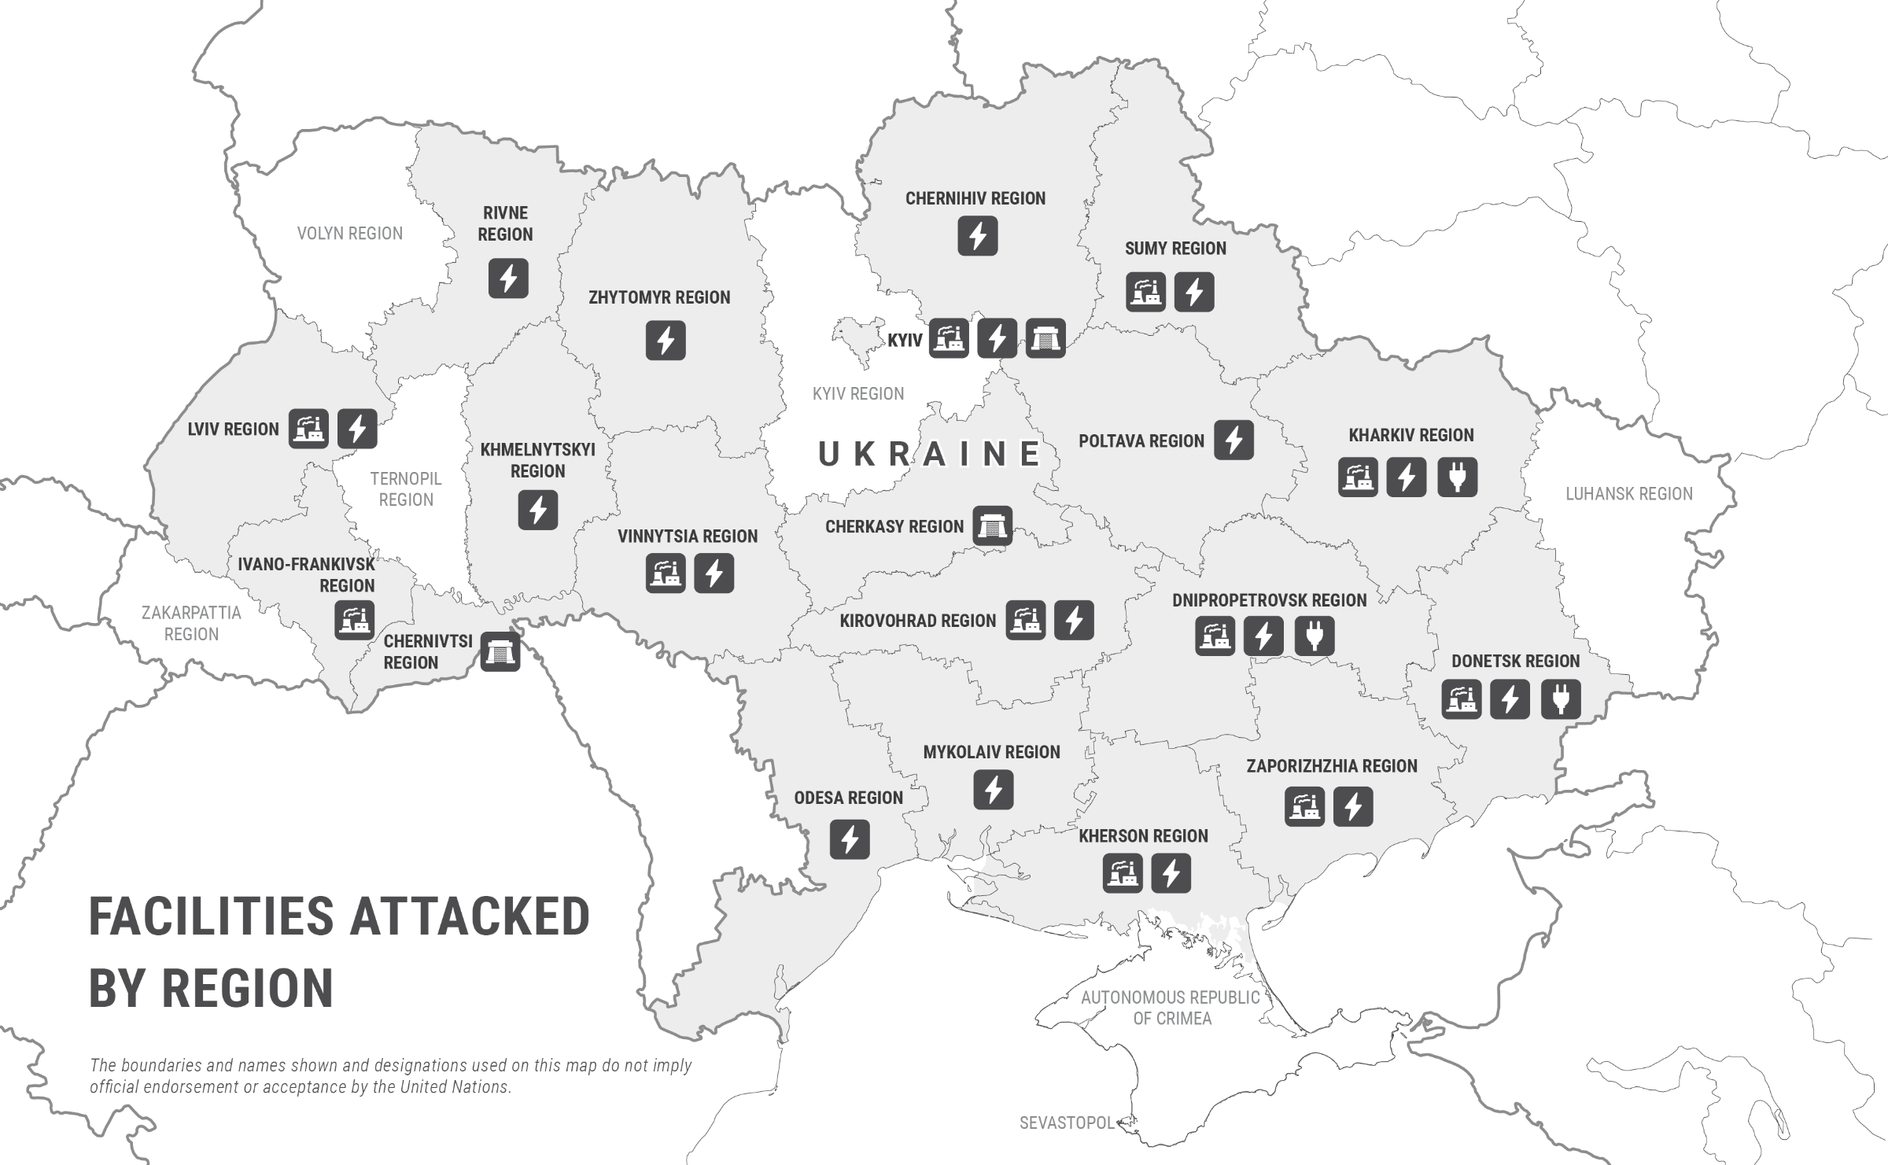
2.5 million households are continually affected
Ukraine’s remarkable resilience and adaptability :
Rapid restoration of power to half a million citizens within 24 hours of Christmas attacks
Improved transformer repair times
Increased energy storage
Notes:
https://storymaps.arcgis.com/stories/2a2d87ae29f34207909828d7198c337c
https://www.iea.org/reports/ukraines-energy-security-and-the-coming-winter/ukraines-energy-system-under-attack
Approximately 80% of Ukraine’s thermal generation capacity and one-third of its hydroelectric capacity have been destroyed or rendered inoperable since the intensified attacks of spring 2024.
The occupation of the Zaporizhzhia nuclear power plant (6 GW capacity) further reduces available generation, leaving Ukraine with only about one-third of its pre-war electricity production capacity.
Ukraine experienced an acute power deficit throughout the summer and into 2025, with rolling blackouts and rationing-often from 2 pm to 11 pm daily-due to insufficient domestic generation and limited electricity imports from neighboring EU countries.
18 large combined heat and power (CHP) plants, along with over 800 boiler houses, have been damaged or destroyed.

Slide 21
Lessons Learnt
Centralized fossil-based infrastructure is vulnerable
Traditional energy systems are insecure
Renewables-based energy systems can ensure energy security and accelerate net-zero transition efforts
Renewable power plants that harness solar or wind energy are particularly suitable for distributed infrastructure and can be installed much more quickly than centralized conventional plants.
*The typical construction timeline for a coal-fired power plant is 4 to 7 years from start to finish
For commercial and utility-scale solar farms: the total process (permitting, procurement, installation, and commissioning) – takes 6 to 14 months
Notes:
https://www.statista.com/statistics/1293492/ukraine-war-casualties/Still Under Fire:
The Evolving Fate of Civilians in Ukraine : https://acleddata.com/2024/02/22/still-under-fire-the-evolving-fate-of-civilians-in-ukraine/

Slide 22
Energy Transition is NOT a luxury
In Ukraine, we do not have the luxury of time
Lessons Learnt
Neither the world does.

Slide 23
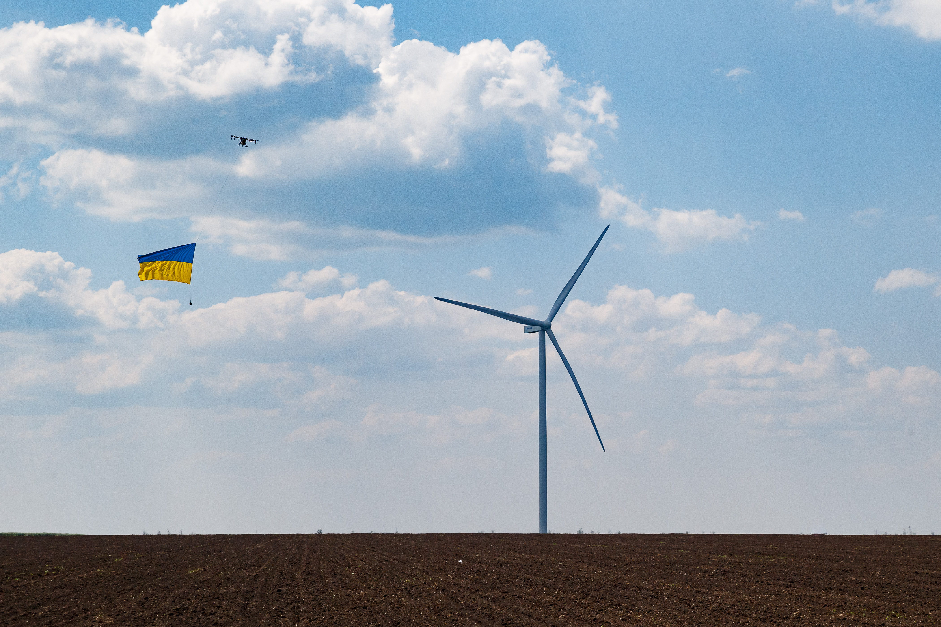
Despite active war phase, Ukraine commissioned 1.6 GW of new renewable energy capacity
Household, commercial, and some utility-scale solar
installations, along with new wind, biomass, and small
hydro projects.
Ukraine has installed more onshore wind power (114 megawatts) since the start of the war than the UK.
Tyligulska wind power plant, constructed just 60 miles from the frontline, provides clean electricity powering about 200,000 homes in the southern region of Mykolaiv.
Notes:
https://www.eceee.org/all-news/news/news-2023/ukraine-built-more-onshore-wind-turbines-in-past-year-than-england/
Much of this growth has focused on microgrids and local storage solutions, which have enabled over 1,000 critical facilities-such as hospitals, schools, and businesses-to maintain operations during frequent blackouts caused by attacks on centralized infrastructure.

Slide 24
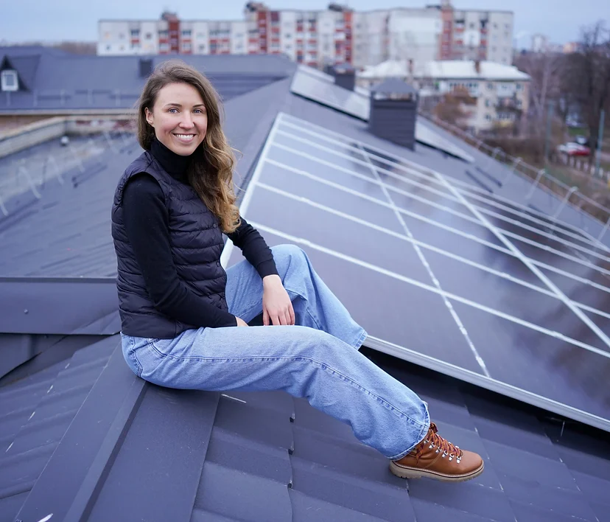
A solar plant with energy storage systems already operating at Chernihiv Secondary School № 19
Solar Initiatives: “100 Solar Schools” and “50 Solar Hospitals”
The Energy Act for Ukraine Foundation
Notes:
Boryslav Hospital by installing a 30 kilowatt solar power plant on the roof - State-owned Ukrnafta, in cooperation with the City Council, lit up - https://ecopolitic.com.ua/en/news/na-lvivshhini-likarnju-obladnali-sonyachnimi-panelyami-za-groshi-gromadi-ta-naftovikiv-2/
Aurora invested in a rooftop solar power plant in Vinnytsia, and the city of Kyiv plans to install solar power plants to supply energy to medical facilities, reinforcing social responsibility through green energy.
Scatec, an international company, is developing a project called "mobile SPP plus batteries". The city of Nizhyn, in cooperation with the German Society for International Cooperation (GIZ), will build an SPP to provide electricity to the water utility.
https://www.energyactua.com/100solarschools + https://laender-analysen.de/uad/pdf/UkrainianAnalyticalDigest009.pdf

Slide 25
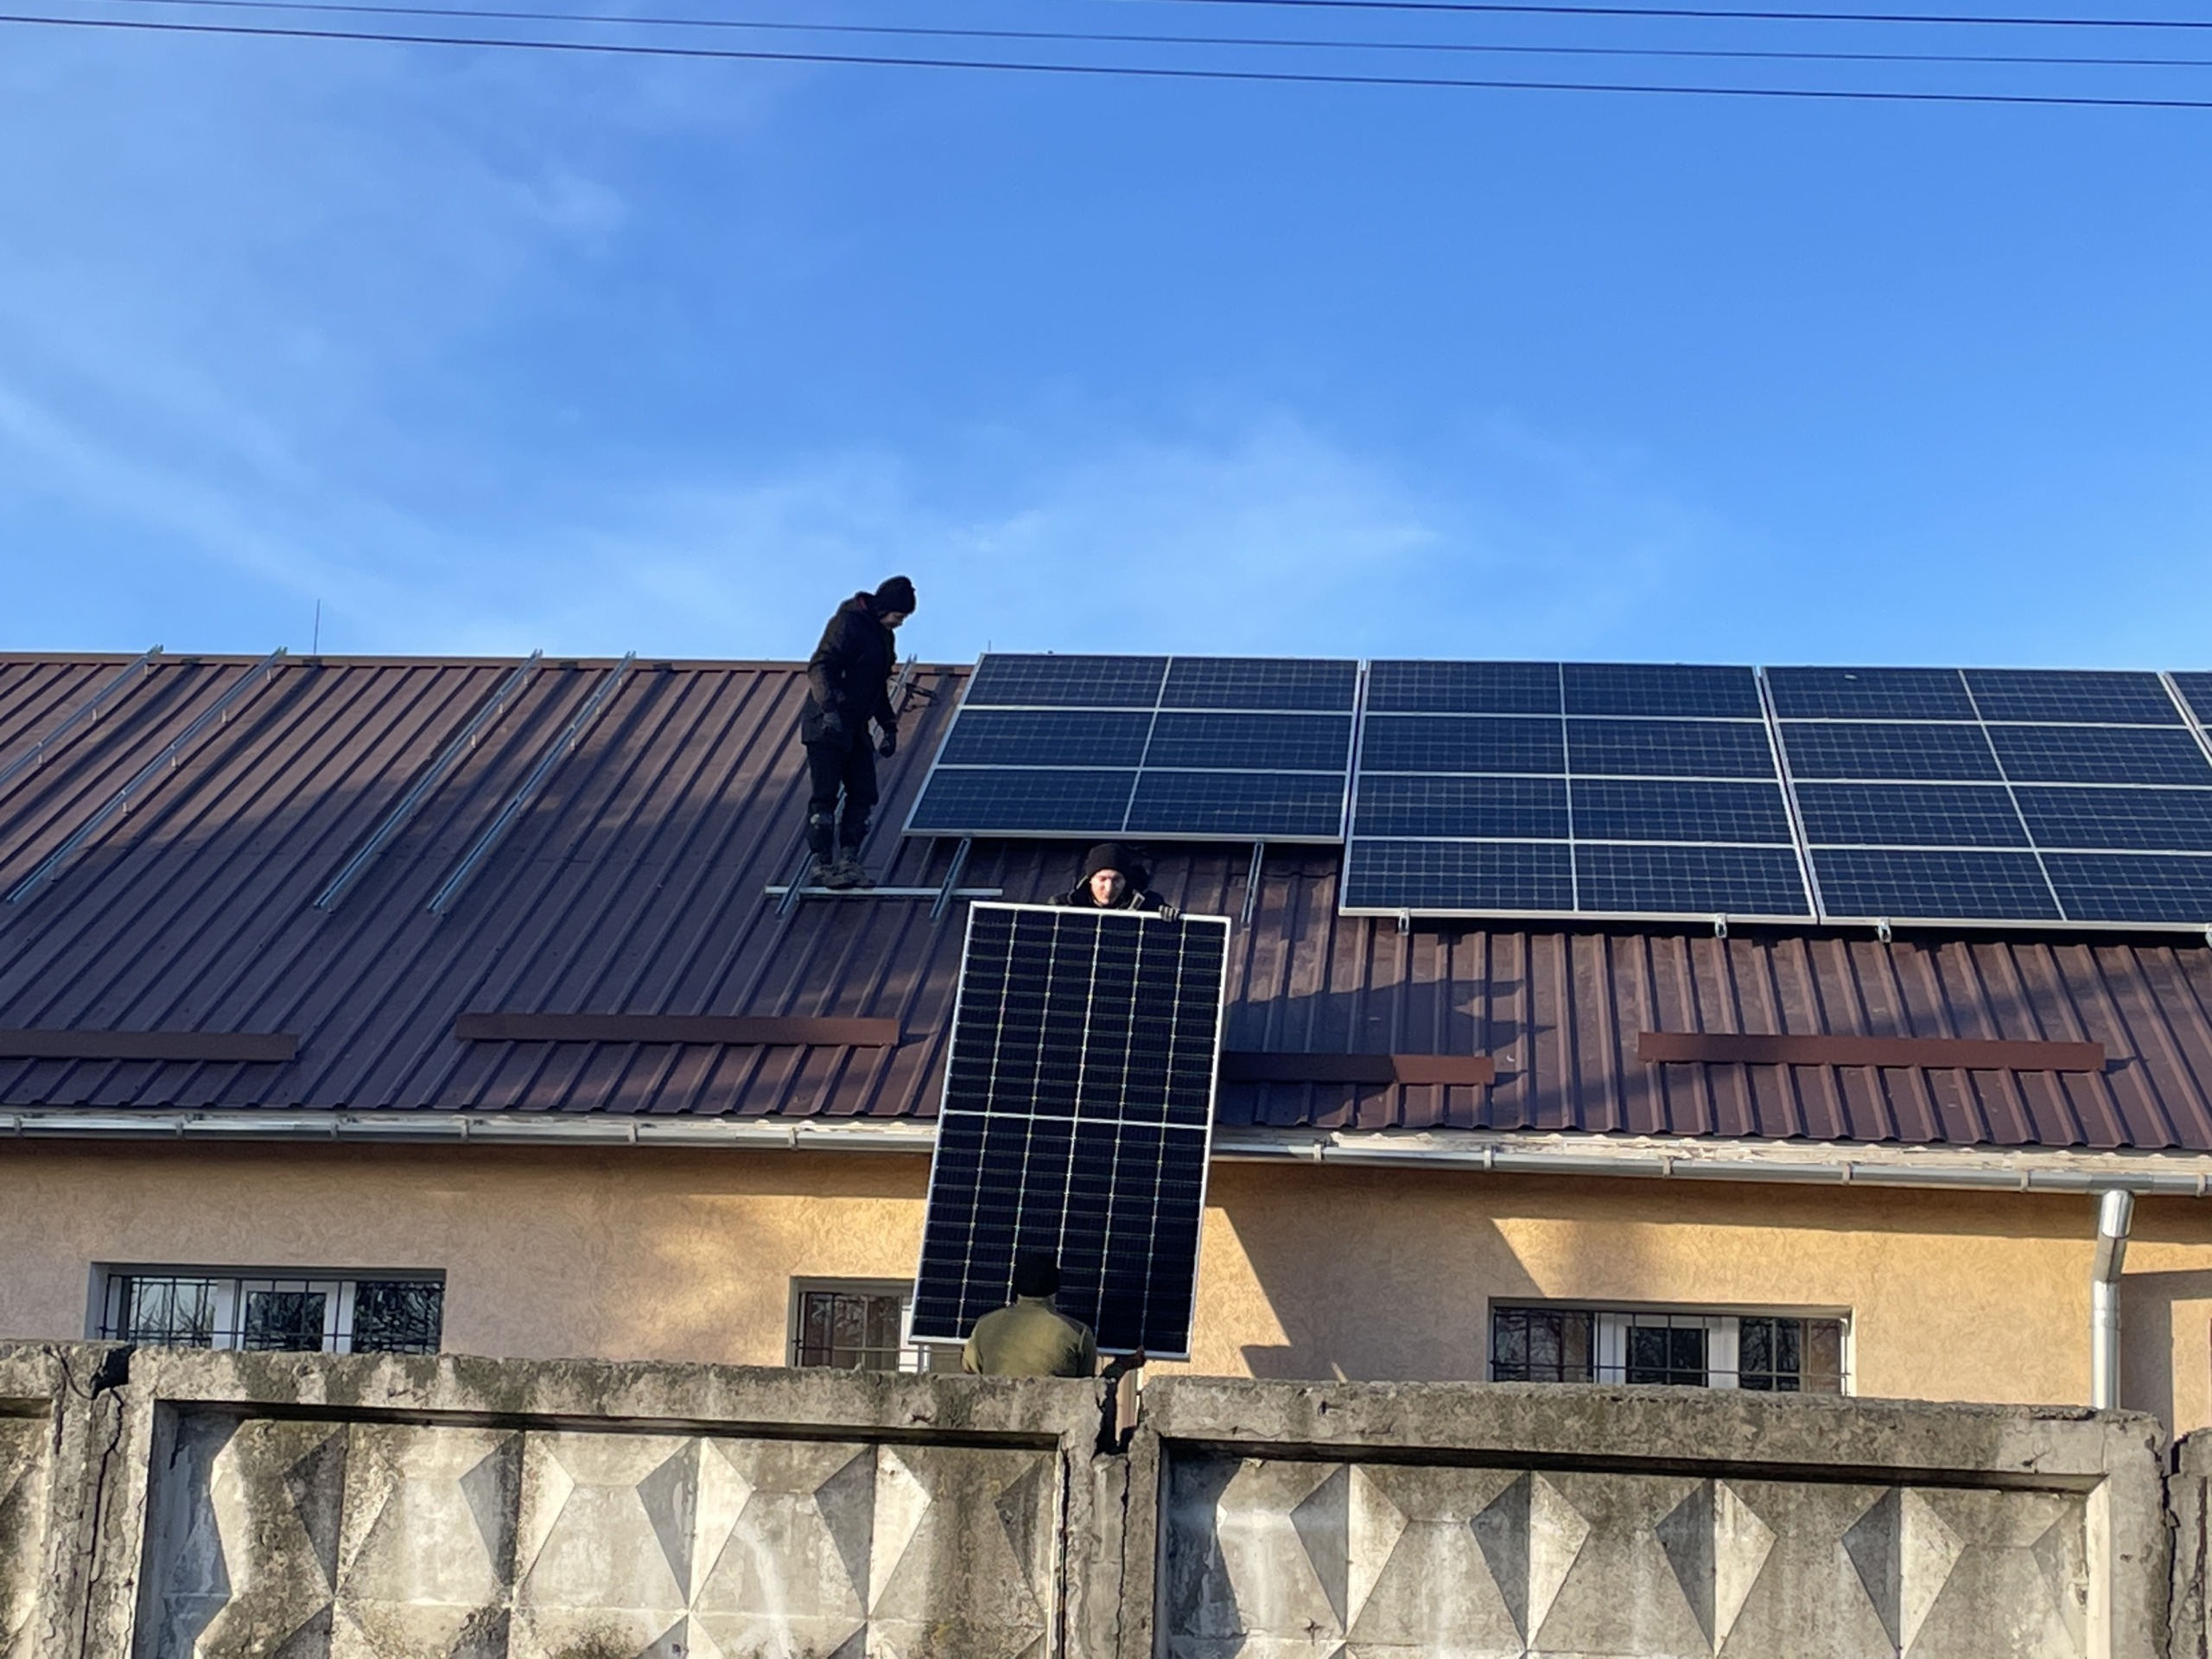
30 kilowatt solar power plant installed on the roof of Boryslav Hospital.
Opened on January 7, 2024, it will produce ~ 25,000 kWh per year,
saving up to 35% of the electricity needed to operate the building.
Funder: Ukrnafta, in cooperation with the City Council
Notes:
Boryslav Hospital by installing a 30 kilowatt solar power plant on the roof - State-owned Ukrnafta, in cooperation with the City Council, lit up - https://ecopolitic.com.ua/en/news/na-lvivshhini-likarnju-obladnali-sonyachnimi-panelyami-za-groshi-gromadi-ta-naftovikiv-2/

Slide 26
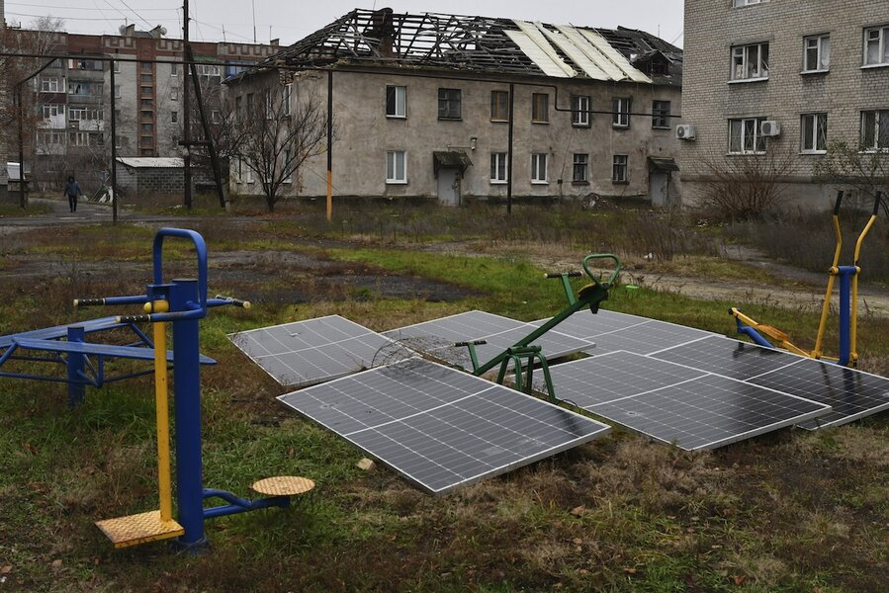
Solar panels in the yard of an apartment building in Lyman, Donetsk region.
Notes:
https://www.csmonitor.com/World/Europe/2024/1120/Ukraine-Russia-war-clean-energy-wind-and-solar

Slide 27
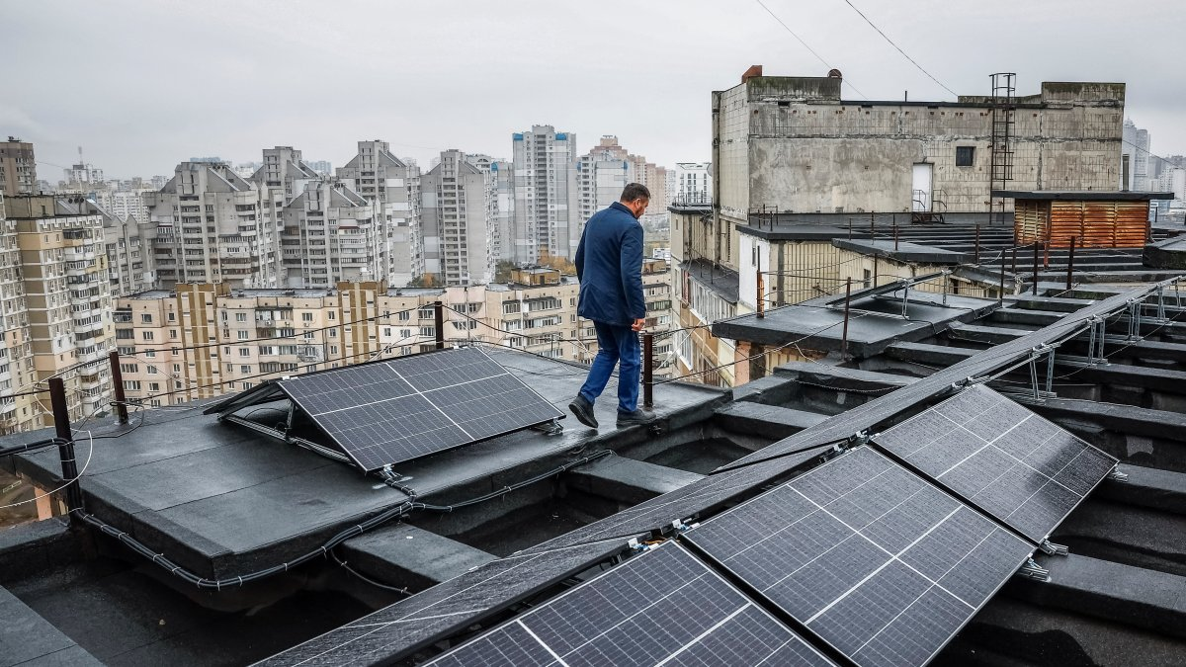
Apartment block in Kyiv installed solar panels for powering elevators and pumps during blackouts

Slide 28

Svitlana Krakovska, Ukraine's top climate scientist, and her husband installed rood top solar panels on the roof of their apartment building in Kyiv.
Notes:
Ukraine's top climate scientist put solar panels on her apartment roof so she could keep the lights on for her son with autism, Business Insider, 2023 https://www.businessinsider.com/svitlana-krakovska-ukraine-rebuild-green-tech-energy-solar-renewable-2023-2

Slide 29
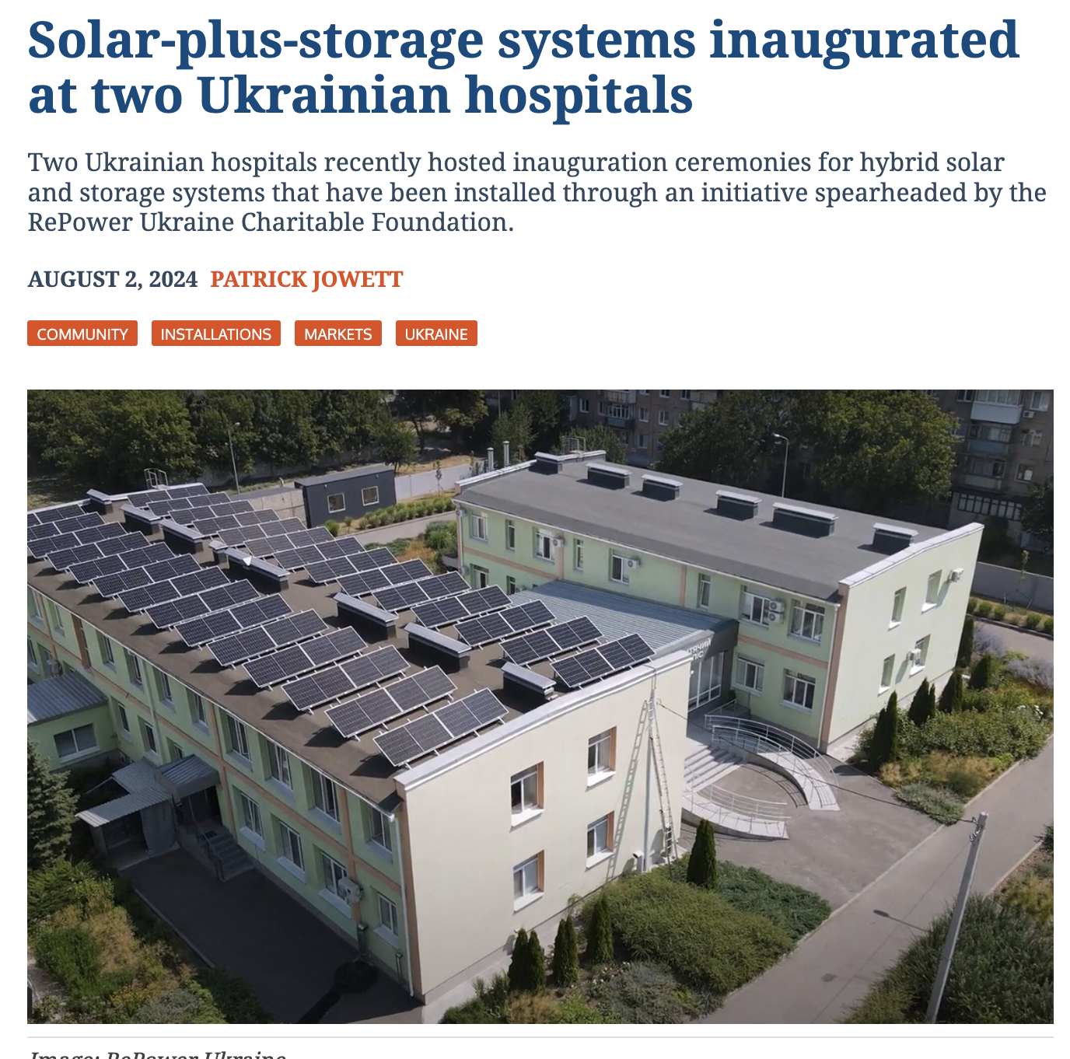
Hospitals in the Ukrainian cities of Kharkiv and Brovary have begun benefiting from solar-plus-storage energy systems

Slide 30
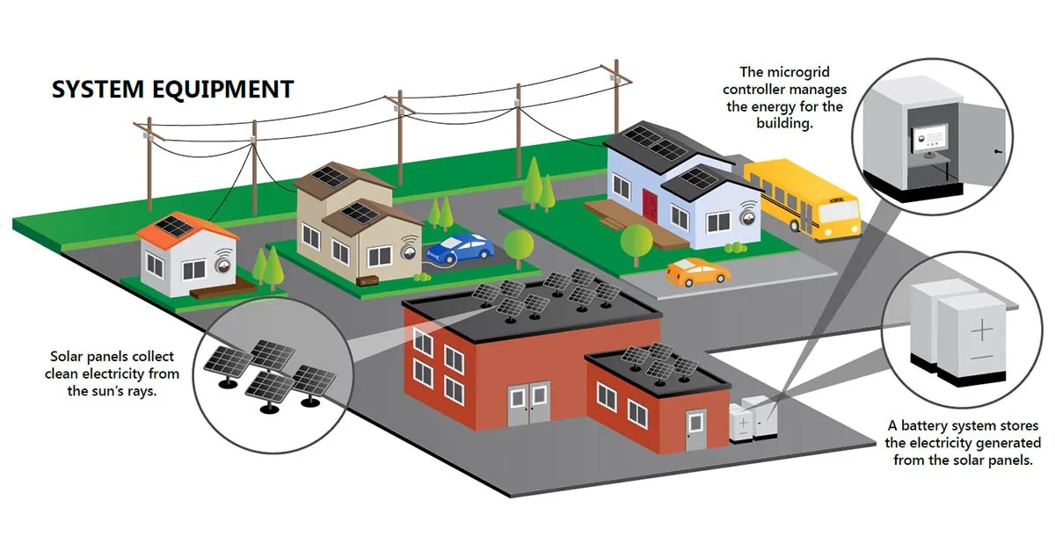
Merefa Community Microgrid:
Distributed Energy Resource Deployment in Ukraine
Merefa is located south of Ukraine’s second- largest city of Kharkiv (30 km from the Russian border). There, Monolith operates a merchant solar photovoltaics (PV) plant that supplies 10% of annual power consumption within the Merefa Territorial Community. In May 2022, the solar PV system suffered an attack by two Iskander missiles, damaging 1,312 PV modules and significantly reducing electricity production. Nevertheless, the solar PV system is still operational at reduced capacity.
A 6.06 MW-DC PV system, with 4.4 MW of assets - already operational or under construction, a 2.5-MW battery energy storage system with 4-hour capacity and dual 532-kW natural gas reciprocating engine generators, plus balance-of-plant equipment.
A total estimated capital cost of $9.85 million USD, with projected annual operations and maintenance costs of $1.02 million USD, while anticipated first-year wholesale market participation revenues are estimated at $0.65 million USD.
The microgrid's resilience capabilities are demonstrated by its 87% probability of maintaining critical load service during extended 96-hour outage periods, ensuring reliable power supply during grid disruptions.
Notes:
https://www.nrel.gov/docs/fy24osti/89666.pdf. - https://www.nrel.gov/docs/fy24osti/89527.pdf

Slide 31
Energy Transition is a key pillar of Ukraine’s Recontruction, Recovery
and EU accession
Net-Zero
A market-based approach could boost net-zero
transition efforts in the long term and provide energy security. These achievements could drive
net-zero technologies down their respective cost curves and build a pathway to faster decarbonization
in other countries of the EU.
Energy security
Developing a strongly renewables-oriented energy
sector in Ukraine and its integration into the EU energy market will contribute to European supply diversification.
Renewable Energy as a Security Solution
Innovation
Ukraine offers a special opportunity to concretely develop a leading model for decarbonization through technological change.
Just transition and Green Jobs
Technical and policy solutions supporting rapid
low-carbon transition in post-war Ukraine will result in significant net socio-economic and ecological benefits.
Ukraine can become a role model for the EU, UK and beyond
Notes:
The European Council of 23 June 2022 decided to grant the status of candidate country to Ukraine, which expressed
a strong will to link reconstruction with reforms on its European path. Ongoing strong support to Ukraine is a key
priority for the Union and an appropriate response to the Union’s strong political commitment to support Ukraine
for as long as necessary.
Energy transition in Ukraine is not just a national concern.
It is a significant component of global and European security.

Slide 32
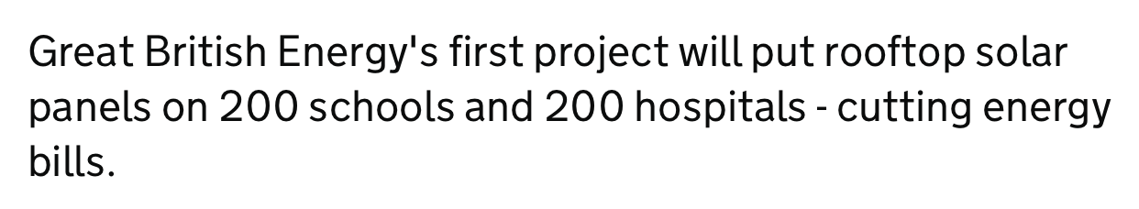
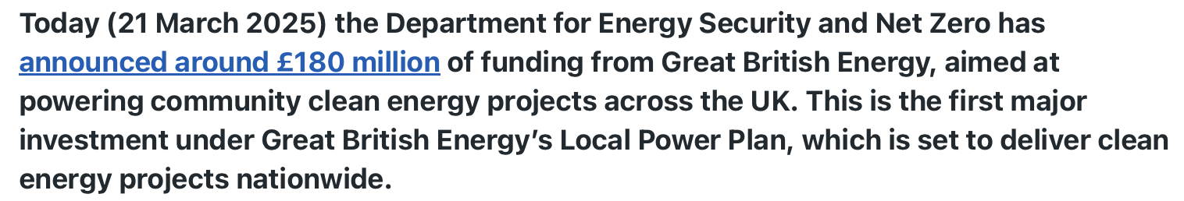
What Ukraine can teach the developed West?
Notes:
Collaborate on energy security or be vulnerable, Britain tells global meeting - https://www.reuters.com/sustainability/boards-policy-regulation/uk-kicks-off-energy-security-summit-with-offshore-wind-supply-chain-investment-2025-04-23/
One Hundred Year Partnership Agreement between the United Kingdom of Great Britain and Northern Ireland and Ukraine https://assets.publishing.service.gov.uk/media/67b871514ad141d9083533c4/CS_Ukraine_1.2025_One_Hundred_Year_Partnership_Agreement.pdf
https://www.gov.uk/government/news/great-british-energy-to-cut-bills-for-hospitals-and-schools

Slide 33
Lessons Learnt: Resilience and Energy Security
National, regional, and global security are inextricably linked
Urgent Need to Phase Out Fossil Fuel Dependence
Bottom-Up Approach to Energy Security :
Local and community-level initiatives have proven crucial for resilience
People-Centered Infrastructure
Decentralized energy systems are more resistant to disruption
Local energy generation reduces vulnerability to external threats
Distributed systems can maintain essential services during crises
Small-scale projects can be implemented and adapted more quickly
Energy security, climate action, and community resilience are deeply interconnected.
Green agenda is not a luxury but an existential necessity for Ukraine, Europe and the world
Notes:
https://www.statista.com/statistics/1293492/ukraine-war-casualties/Still Under Fire:
The Evolving Fate of Civilians in Ukraine : https://acleddata.com/2024/02/22/still-under-fire-the-evolving-fate-of-civilians-in-ukraine/

Slide 34

2025: Ministry of Environmental Protection and Natural Resources of Ukraine presents draft law “On the Principles of Green Recovery of Ukraine,”
aiming to embed environmental and climate priorities into the country’s post-war reconstruction and guide its transition toward a green economy.
The draft law outlines the principles of sustainable recovery, introduces criteria for green investment, and calls for the creation of a national green taxonomy aligned with EU standards.
Notes:
https://mepr.gov.ua/povidomlennya-pro-oprylyudnennya-proyektu-zakonu-ukrayiny-pro-zasady-zelenogo-vidnovlennya-ukrayiny/

Slide 35
Does NET ZERO = Inclusive?
Does NET ZERO = Just?
Does NET ZERO = Recovery?
Welfare and growth can be decoupled from greenhouse gas emissions, meaning that a green recovery and a welfare-maximising recovery are conceivably the same thing.
Zagoruichyk, A., Savytskyi, O., Kopytsia, I., O'Callaghan, B. (2023).
The Green Phoenix Framework: Climate-positive Plan for Economic Recovery of Ukraine.

Slide 36
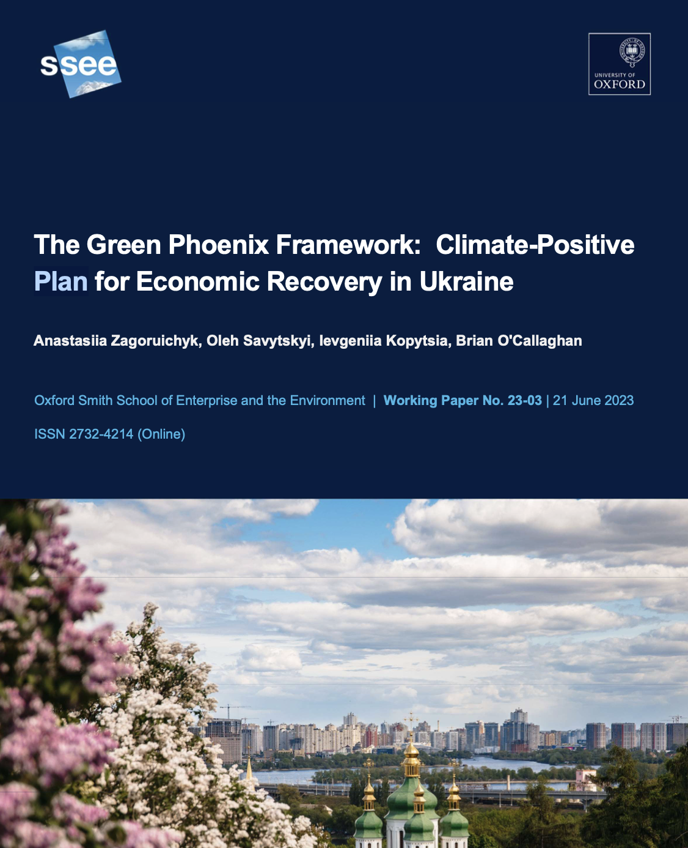


Slide 37
FINDINGS:
Spending on fossil fuel industries is unlikely to return high dividends for the public and introduces large economic and environmental risks.
- Instead of developing new gas fields to increase energy access and high-value exports, we propose scaling low-carbon energy production and decarbonising domestic industrial processes.
If Ukraine is to pursue a low-carbon economy, it could benefit from becoming a technological leader in sectors such as hydrogen production or “green” steelmaking. Large-scale investment in research and development could attract talent home and catalyse Ukrainian climate leadership.
Training and reskilling are likely to be core components to any Ukrainian recovery plan.
If a low-carbon shift is desired, much of these investments in human capital would need to prioritise skills relevant to the low-carbon economy, such as solar panel installation or retrofitting a house.

Slide 38
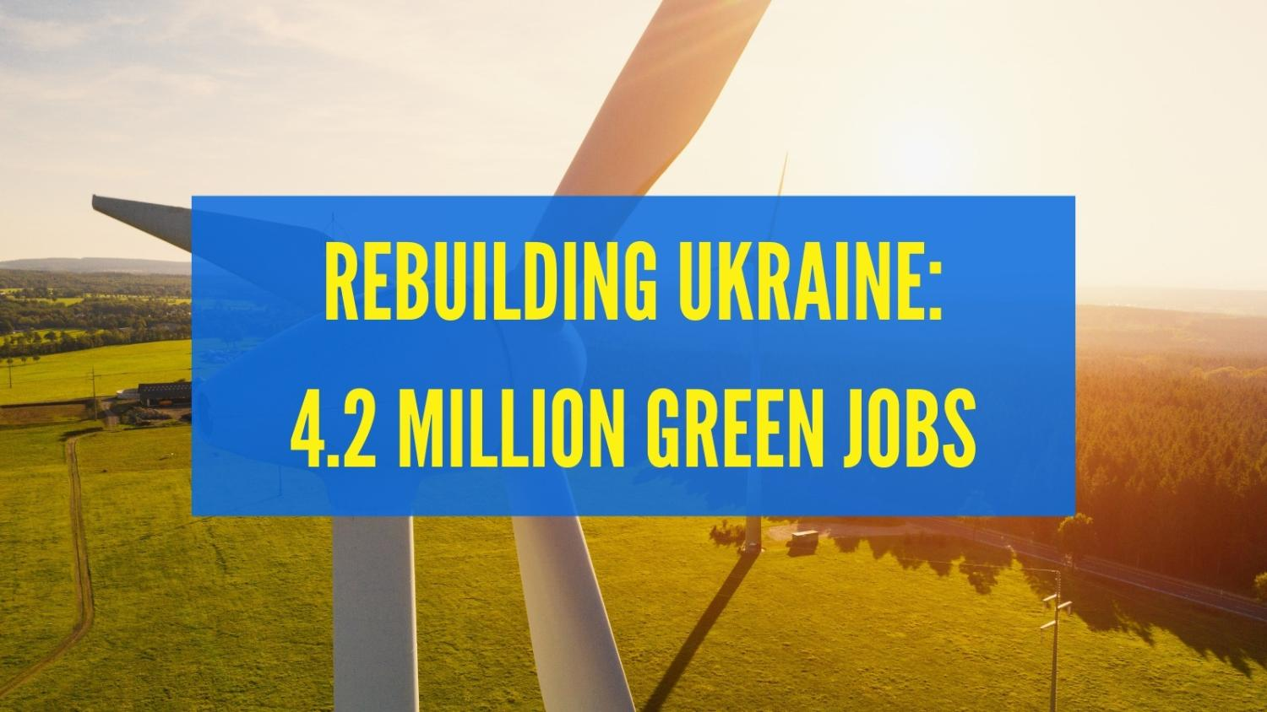

Notes:
https://razomwestand.org/en/article/green-post-war-reconstruction-ukraine-can-generate-over-42-million-jobs#:~:text=war%20%2F%20Press%20Release-,Green%20Post%2DWar%20Reconstruction%20Of%20Ukraine%20Can%20Generate%20Over%204.2,million%20people%20fled%20the%20country.

Slide 39

The green transition represents more than an environmental or economic transformation; it is the cornerstone upon which a new, more secure global order must be built.
The time for gradual change has passed – the path to global security runs through the immediate and comprehensive energy transition.
Notes:
The EU framework represents a new generation of policy and will require significant financial support to make the necessary transformation. The business sector will also need time and resources to modernize and adjust to these rules. All of this will require clear ownership and strong leadership by the Government. Done well, this will provide the confidence needed to attract the necessary investors.

Slide 40
Does NET ZERO = PEACE?

Slide 41
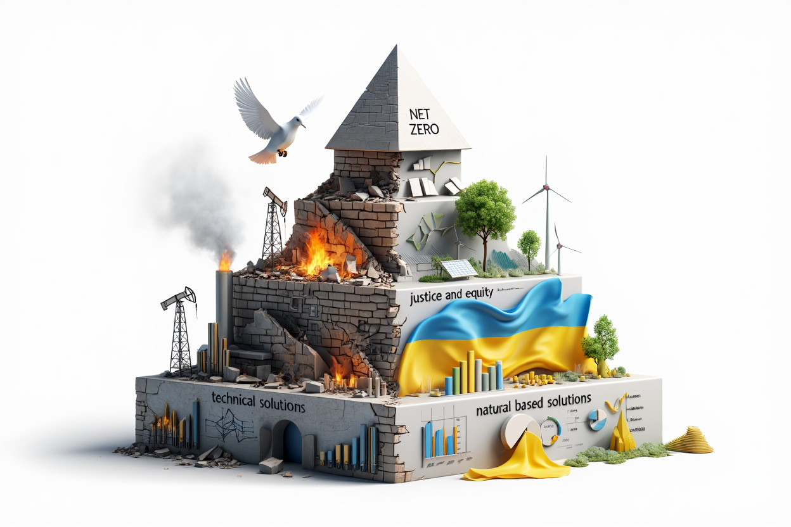
Net Zero as Peacebuilding Tool
Disrupting cycles of resource competition
Enabling more equitable distribution of energy benefits
Fostering cooperation across divided communities
Net zero transitions offer more than
environmental benefits—they provide
frameworks for broader societal resilience
Net zero can simultaneously address
carbon reduction, energy security,
and justice concerns
From Technical Solutions to Social Transformation
Moving beyond technocratic approaches to carbon reduction
Recognizing interdependencies between sustainability, security, &
peace
Post-conflict recovery &
environmental restoration
- Just transition initiatives in
post-industrial communities
- Resource competition
transformed into cooperation
Net Zero Framework address climate impacts and build more secure and resilient societies
Notes:
Resilience as an ideal that encourages to “emerg[e] better off than before serious setbacks.” (C) Encarnacion
Although it is impossible to erase the impact of a setback— it can be possible for people to end up with lives that are in some sense better or more meaningful than before.
Net Zero as a Pathway to Resilience: Beyond Carbon Reduction
Net zero transitions offer more than environmental benefits—they provide frameworks for broader societal resilience
Today's compounding crises (climate, geopolitical tensions, energy insecurity, social inequities) require integrated solutions
Net zero strategies can simultaneously address carbon reduction, energy security, and justice concerns
Case Studies Demonstrating Impact
Post-conflict environmental restoration in Ukraine
Just transition initiatives in post-industrial communities
Examples of resource competition transformed into cooperation
From Technical Solutions to Social Transformation
Moving beyond technocratic approaches to carbon reduction
Recognizing interdependencies between sustainability, security, and peace
Centering justice and equity within energy transition planning
The "(Re)imagining Resilience" Framework
Integration of technical innovation with social transformation
Practical guidance for diverse stakeholders (policymakers, communities, organizations)
Methods to navigate complex, interconnected challenges
Net Zero as Peacebuilding
Disrupting cycles of resource competition
Enabling more equitable distribution of energy benefits
Fostering cooperation across divided communities
Path Forward
Creating solutions that simultaneously address climate impacts and build more secure societies
Practical steps for implementing justice-centered transition strategies
Building resilient systems that contribute to peaceful futures

Slide 42
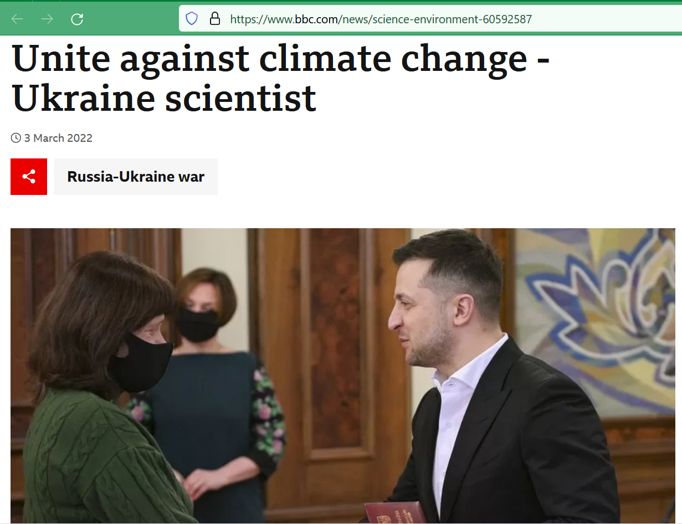
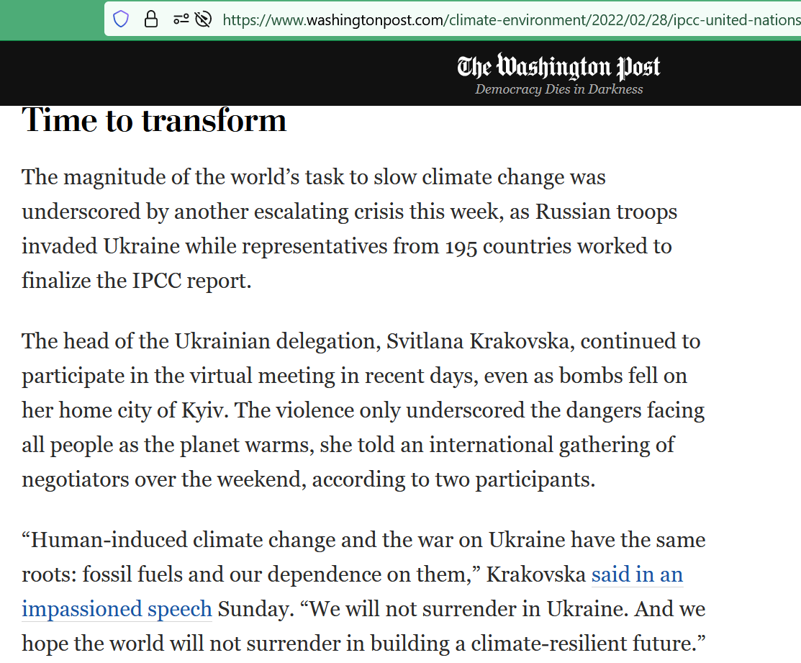

Slide 43

CHALLENGES?
The US democracy score has declined in recent years, with concerns about democratic norms, polarization, and the rule of law.
Trump Factor: Trump’s policies favor fossil fuel expansion and deregulation, aligning with interests that often resist democratic reforms and climate action.

Slide 44
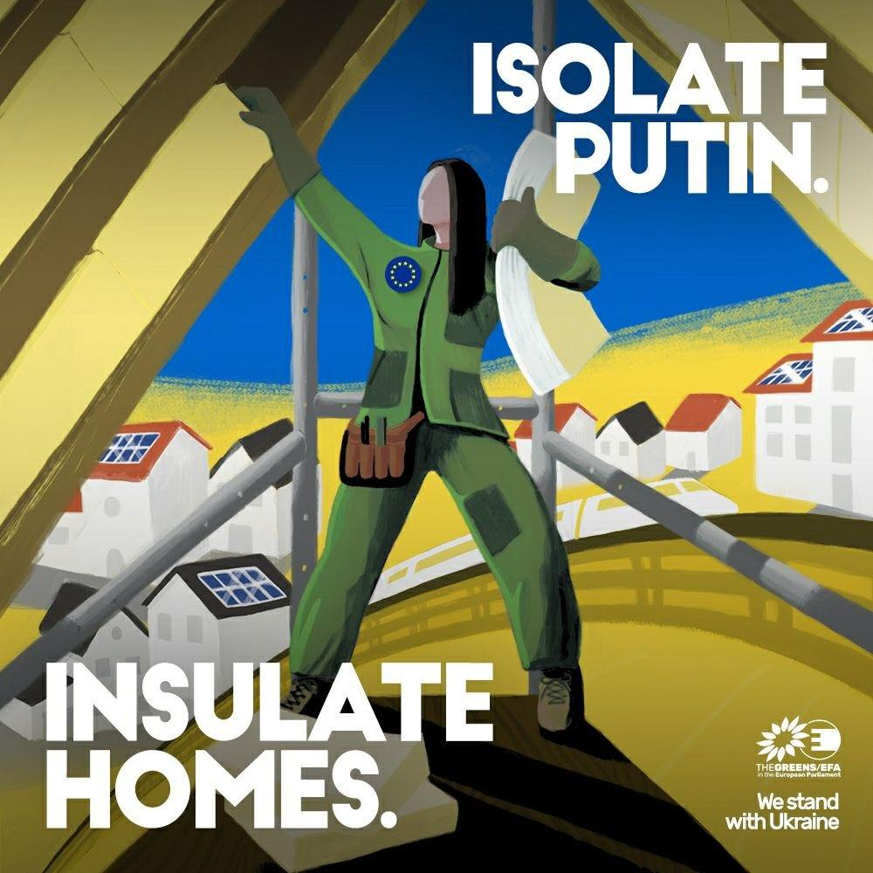

Slide 45

Thank you!
A short quiz as a food for thought:
I can see the climate changing, and so can you

Slide 46
Thank you!
Dr. Ievgeniia Kopytsia
MSCA4Ukraine Research Fellow, University of Genoa
Associate Professor, Yaroslav Mudryi National Law University
Head, Centre for Sustainable Development and Environmental Law
📧 ievgeniia.kopytsia@ikem.de
🔗 LinkedIn: https://www.linkedin.com/in/ievgeniiakopytsia/

